Slide 1
DIABETES PREDICTION
BY: -
RISHAB DUNG(2K20CSUN01083)

Slide 2
TABLE OF CONTENTS
INTRODUCTION
OBJECTIVES
DATA COLLECTION
DATASET PRIVIEW
TECHNOLOGY USED
LIBRARIES USED
CONCLUSION

Slide 3
INTRODUCTION
The diabetes is threatening a lot of people nowadays, without having a perfect cure for it. There are actually two types of diabetes, namely Type 1 and Type 2.The type 2 diabetes is commonly called as diabetes mellitus. It can be defined as a chronic condition that affects the way the body processes blood sugar (glucose).We consider the mellitus here. After deep researches we found that, that some parameters are directly responsible to for the mellitus to occur. By using the data of the people with and without diabetes, a dataset has been build. We use that dataset to classify the people who are in the risk of getting diabetes.

Slide 4
OBJECTIVES
The main objective of this study is to develop a machine learning (ML)-based system for predicting diabetic patients.
To analyze feature selection methods and understand their working principle.
To determine significant risk factors based on medical dataset which may lead to diabetes.

Slide 5
DATA COLLECTION
The dataset is publicly available on the Kaggle Website as Predict Diabetes From Medical Records. The datasets consist of several medical predictor (independent) variables and one target (dependent) variable, Outcome. Independent variables include the number of pregnancies the patient has had, their BMI, insulin level, age, and so on.

Slide 6
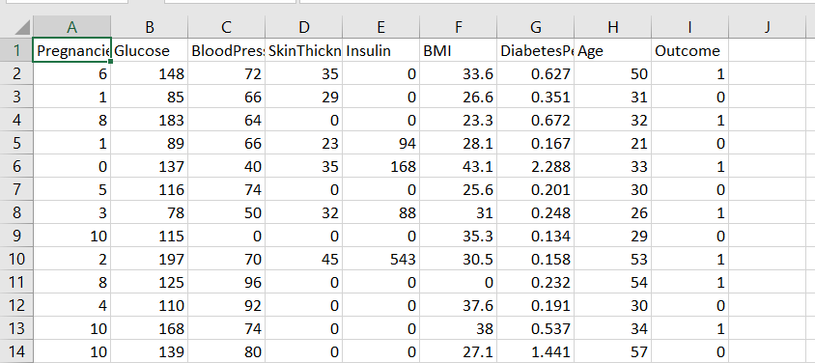
DATASET PRIVIEW

Slide 7
TECHNOLOGY USED
We have used R language and the platform used to develop this project is R studio.
The main purpose of designing this system is to predict the risk of diabetes.

Slide 8
LIBRARIES USED
library(ggplot2)
library(ggvis)
library(corrplot)
library(caTools)
library(ROCR)

Slide 9
CONCLUSION
The results can be improved by applying the feature scaling and data cleaning. From this project we predict the type 2 diabetes, commonly called as diabetes mellitus. As a result it can help to improve their health conditions.

Slide 10
THANK YOU

